Slide 1

Synergy of Knowledge Graphs and Machine Learning: Applications, Tools and Trends
Vamsee Muppavarapu
Senior Manager – Principal Data Visualization Architect
Worldwide Patient Safety (WWPS), DD IT
Bristol Myers Squibb

Slide 2
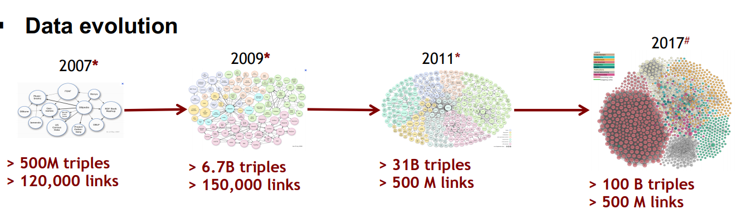
Interesting Facts about Data

Slide 3
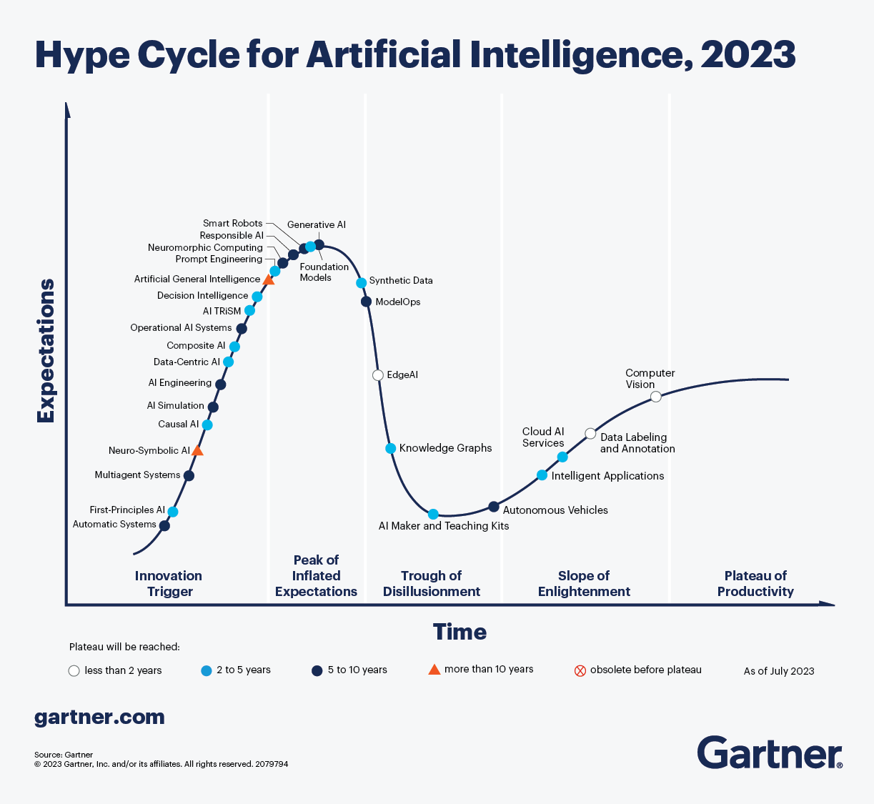
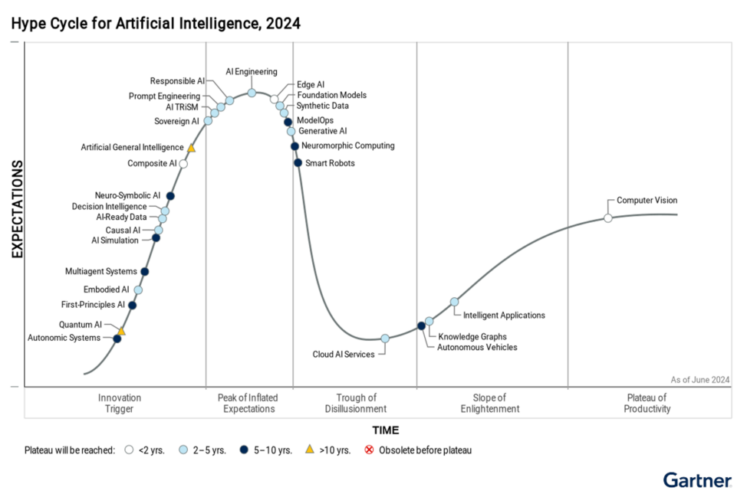
Gartner Hype Cycle

Slide 4
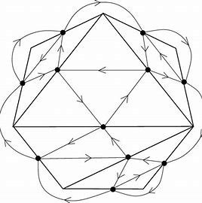
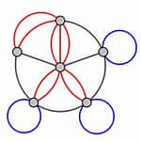
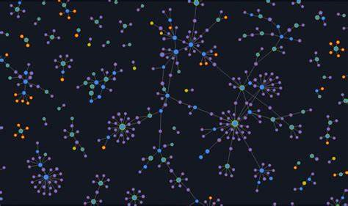
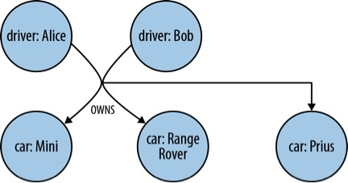
What is a Graph?
Graph – Connections/Edges/Relations from one object/resource/node/vertex to another
Modeling any statement as a connection between any two nodes
Connecting or linking multiple heterogeneous data sources
Facts expressed in the Graph with underlying Graph model giving the semantics of facts
Various Types
Directed
Undirected
Multigraphs
Quiver
Hypergraphs

Slide 5
When to use Graph databases?
Data is highly connected
Data is dynamic and the data model keeps changing often
Retrieval and analytics is more important than storage.
Why Graphs for Knowledge Representation?
Flexible for any changes in underlying model
Integration from multiple heterogeneous data sources is simple
Easy to infer and reason
More intuitive representation for querying paths which represent indirect relations between entities

Slide 6
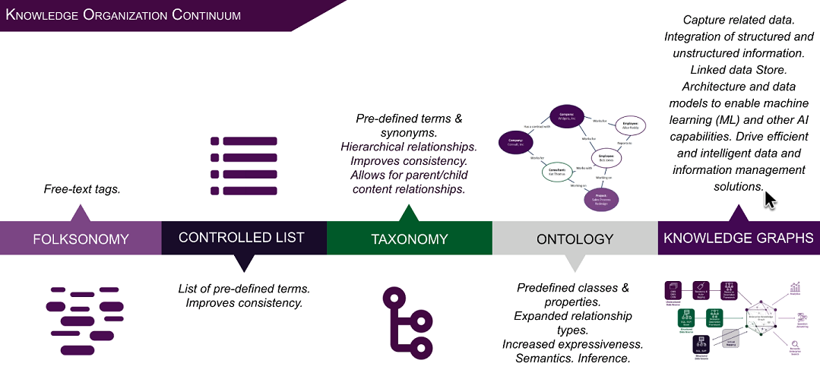
Representation of Knowledge – Informal to formal
Courtesy: EK Consulting

Slide 7
What is a Knowledge Graph?
Graphs which help exploit power of diverse, dynamic and large collections of data
Fabric to integrate, manage and extract value from diverse sources of data
A concise and intuitive way of abstraction of domain data
Ever evolving shared substrate of Knowledge within a domain or community
Less rigid schema
Knowledge Graphs are built based on these three dimensions –
schema (high level structure),
identity (mapping to real world entity)
context (setting in which knowledge is held true)
Knowledge Graphs are highly diverse in structure and granularity
Types – Open Knowledge Graphs, Enterprise Knowledge Graphs

Slide 8
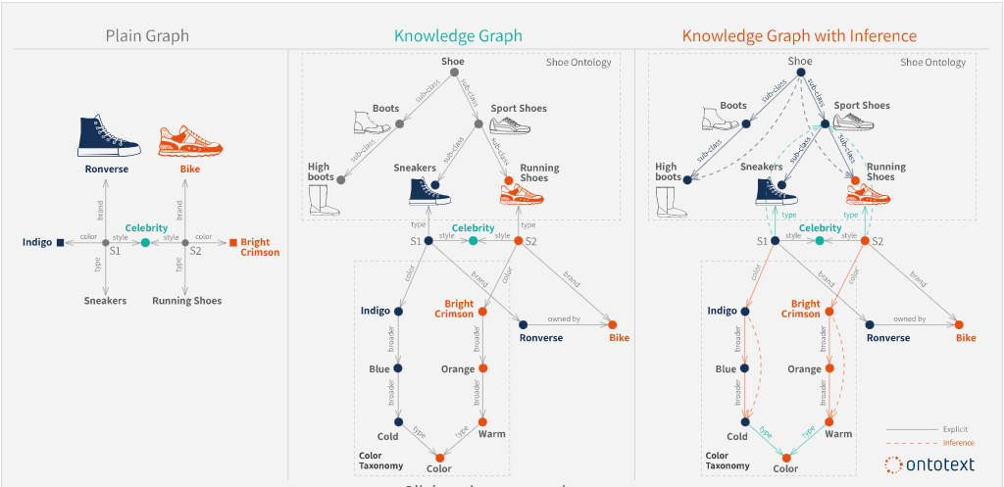
Graph vs Knowledge Graph
Courtesy: Ontotext

Slide 9
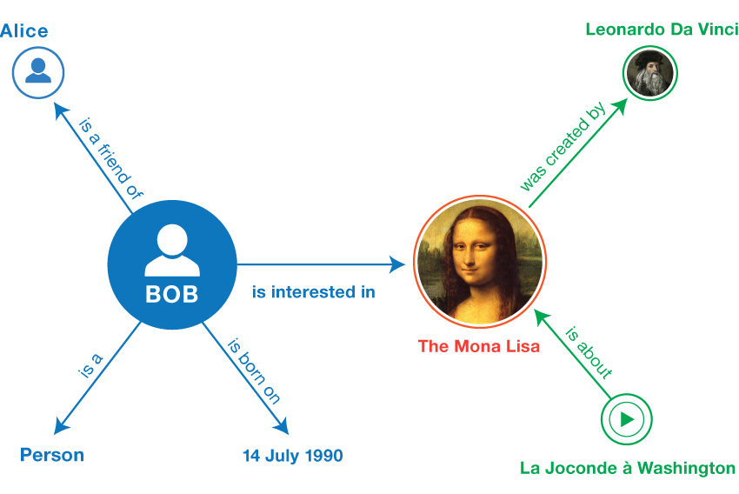
How is Data modelled as Graph?
Widely known Graph Models
Property Graph Models
Semantic Graph Models
Any statement has Subject Predicate Object (SPO)
Triple
Nouns form Nodes/Vertices in Graph
Verbs/Actions represent Relationships/Edges in Graph

Slide 10
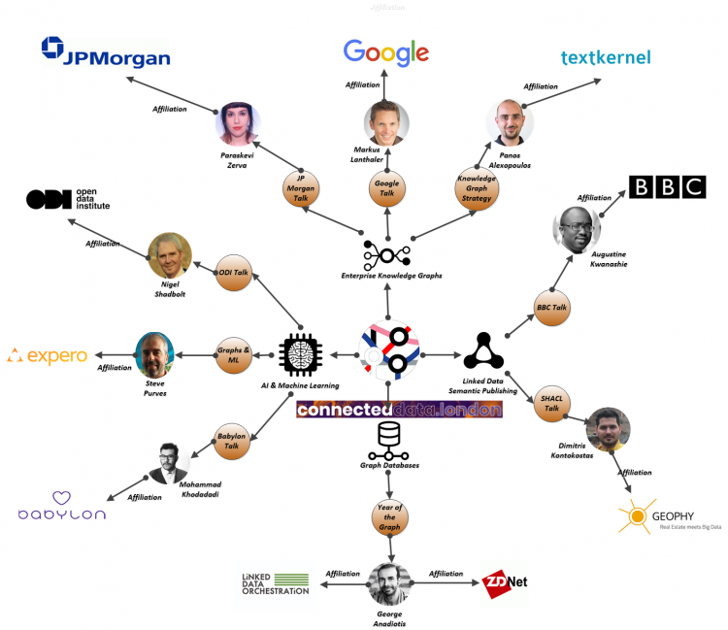
How is Data modelled as a Graph?
Courtesy: ResearchGate

Slide 11
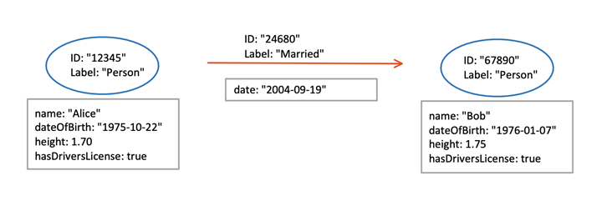
Labelled Property Graphs - LPGs
Node – ID, Key Value Pairs of attributes
Edge – ID, Key Value Pairs of attributes
Standard is not available for structure and semantics of nodes and edges
Query language is specific to each implementation of LPGs
Cypher – Neo4J
Tiger Graph – GSQL
Apache TinkerPop – Graph Computing Platform – Gremlin Query Language
Courtesy: Neo4J

Slide 12
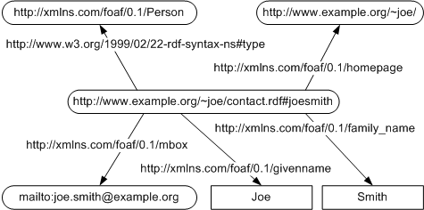
Semantic Graphs – RDF and OWL Based
Node – Class/Individual – Instance of a Class
Edge – Property – Taxonomical or Non taxonomical/Instance of Property
World Wide Web Consortium Standard
Every node/edge has a unique identity – IRI/URI
Easy Integration of Graphs from multiple sources
Flexible for extension
Courtesy: RDF primer

Slide 13
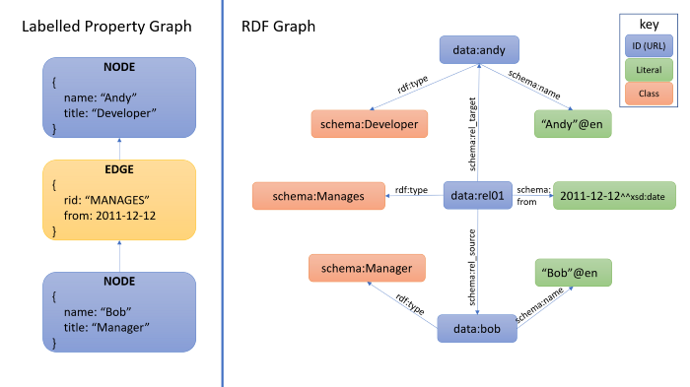
LPG and RDF for same Data
Courtesy: TerminusDB Community

Slide 14
Richness of RDF over LPG
Capturing Schema in a Graph
Support for Validation and Data Integrity
Capturing Rich Rules
Support for Inheritance and Inference
Globally Unique Identifiers
Resolvable Identifiers
Connectivity Across Graphs
Better Solution to Graph Evolvability

Slide 15
Richness of LPGs over RDF
Intuitive data modelling
Flexibility
Efficient Query performance
Scalable
Rich Visualization
Role based controls
Application specific implementation

Slide 16
LPG vs RDF
Aspect | Labeled Property Graphs (LPGs) | Semantic Graphs (RDF Graphs)
Simplicity and Usability | Easier to understand and use, intuitive model resembling a whiteboard sketch. | More complex, requires understanding of RDF, SPARQL, and ontologies.
Performance | Optimized for performance, especially for traversing large graphs and executing complex queries. | May have performance overhead due to handling RDF triples and reasoning.
Flexibility | More flexible schema design, allowing easy addition or removal of properties and relationships. | Requires a more rigid schema defined by ontologies, less flexible for certain applications.
Query Language | Uses Cypher, a declarative query language that is easy to learn and use, similar to SQL. | Uses SPARQL, which can be more complex and less intuitive for those not familiar with RDF.
Tooling and Ecosystem | Supported by a wide range of tools and libraries, such as Neo4j, with robust features for graph analytics and visualization. | Tools available but ecosystem can be less mature and more fragmented compared to LPGs.
Use Cases | Ideal for fast, flexible, and scalable graph operations like social networks, recommendation engines, and fraud detection. | Better suited for applications requiring rich semantics and reasoning, such as knowledge representation and data integration.
Notes:
Simplicity and Usability
LPGs: Easier to understand and use, especially for developers familiar with traditional databases. The model is intuitive, resembling a whiteboard sketch with nodes and relationships.
Semantic Graphs: Can be more complex due to the need to understand RDF, SPARQL, and ontologies.
2. Performance
LPGs: Often optimized for performance, especially for traversing large graphs and executing complex queries quickly.
Semantic Graphs: May have performance overhead due to the need to handle RDF triples and reasoning.
3. Flexibility
LPGs: More flexible in terms of schema design. You can easily add or remove properties and relationships without significant overhead.
Semantic Graphs: Require a more rigid schema defined by ontologies, which can be less flexible for certain applications.
4. Query Language
LPGs: Use Cypher, a declarative query language that is easy to learn and use, similar to SQL.
Semantic Graphs: Use SPARQL, which can be more complex and less intuitive for those not familiar with RDF.
5. Tooling and Ecosystem
LPGs: Supported by a wide range of tools and libraries, such as Neo4j, which provide robust features for graph analytics and visualization.
Semantic Graphs: While there are tools available, the ecosystem can be less mature and more fragmented compared to LPGs.
6. Use Cases
LPGs: Ideal for applications requiring fast, flexible, and scalable graph operations, such as social networks, recommendation engines, and fraud detection.
Semantic Graphs: Better suited for applications requiring rich semantics and reasoning, such as knowledge representation and data integration.

Slide 17
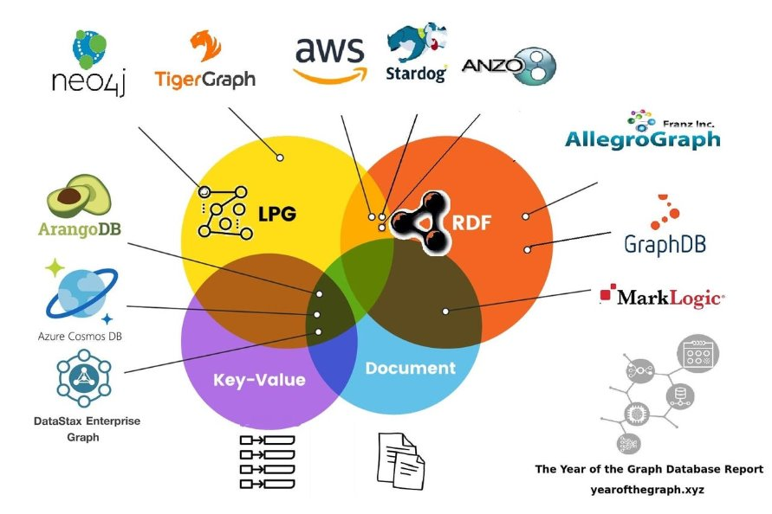
Knowledge Graph Tools
Protégé
Pool Party
Anzo Semantics
Top Braid
AWS Neptune
Stardog
Neo4J
Tiger Graph

Slide 18
Tool Comparison
Feature/Tool | Protégé | Pool Party | Anzo Semantics | Ontotext | AWS Neptune | Stardog | Neo4J | Tiger Graph
Type | Ontology Editor | Semantic Suite | Semantic Suite | Semantic Suite | Graph Database | Knowledge Graph | Graph Database | Graph Database
Primary Use | Ontology creation | Taxonomy & Ontology | Data Integration | Ontology & Data | Managed Graph DB | Data Integration | Graph Analytics | Real-time Analytics
Data Model | RDF/OWL | RDF/OWL | RDF/OWL, LPG | RDF/OWL | RDF, LPG | RDF, LPG | LPG | LPG
Scalability | Limited | High | High | High | High | High | High | High
Query Language | SPARQL | SPARQL | SPARQL, Cypher | SPARQL | SPARQL, Gremlin | SPARQL, GraphQL | Cypher | GSQL
Visualization | Basic | Advanced | Advanced | Advanced | Basic | Advanced | Advanced | Advanced
Integration | Limited | Extensive | Extensive | Extensive | Extensive | Extensive | Extensive | Extensive
AI/ML Support | Limited | Moderate | High | Moderate | High | High | High | High
Deployment | Desktop | Cloud/On-Premise | Cloud/On-Premise | Cloud/On-Premise | Cloud | Cloud/On-Premise | Cloud/On-Premise | Cloud/On-Premise
Cost | Free | Paid | Paid | Paid | Paid | Paid | Paid | Paid

Slide 19
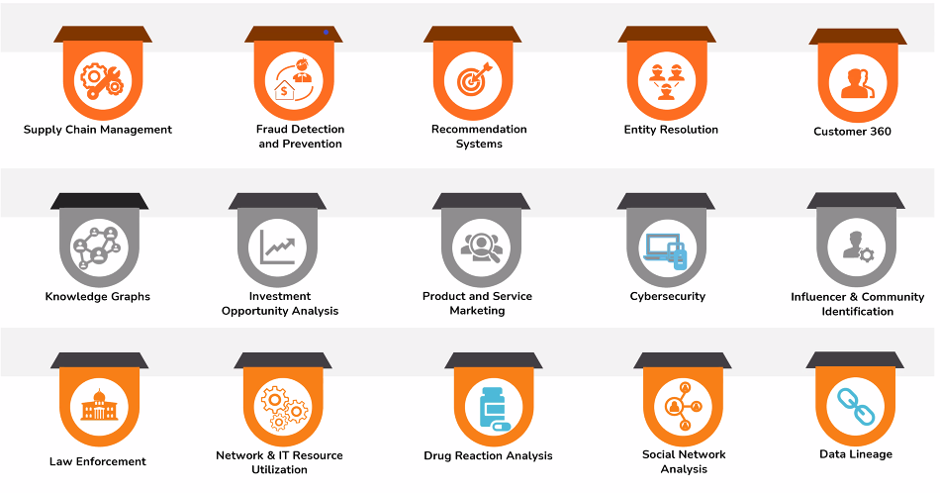
Application Areas
Healthcare – HCP targeting, identifying patient referrals and leakage, Key Opinion leaders
Social Networks (Facebook Graph) – Homogenous cohorts, Targeted Marketing, Campaigns
IKEA Knowledge Graphs – Geographic and demographic segmentation, Positioning
Citation Networks

Slide 20
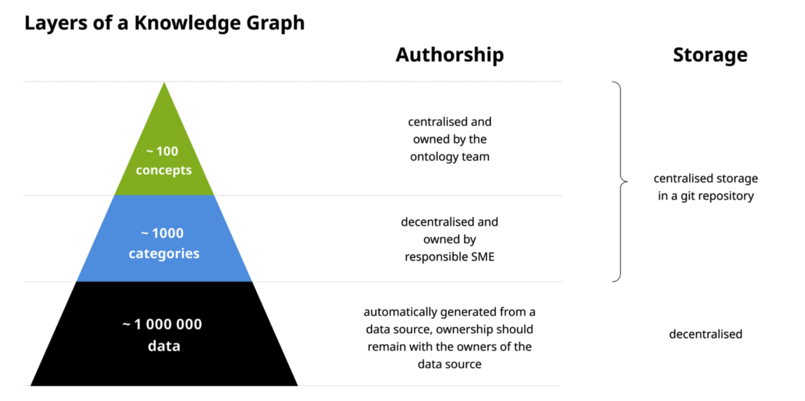
Use case - IKEA

Slide 21
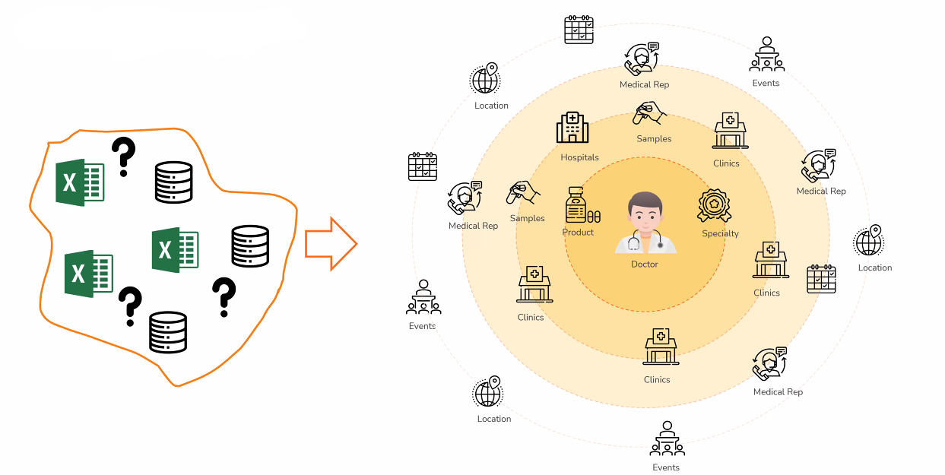
Use case - HCP 360

Slide 22
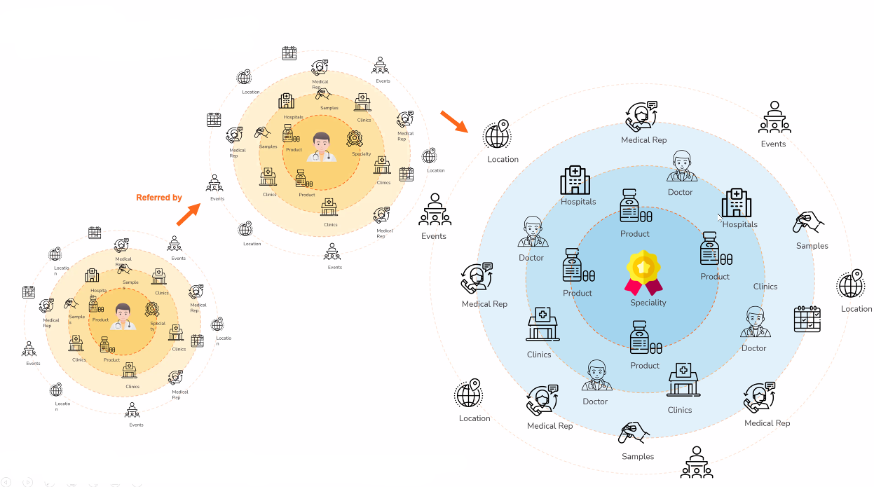
HCP 360

Slide 23
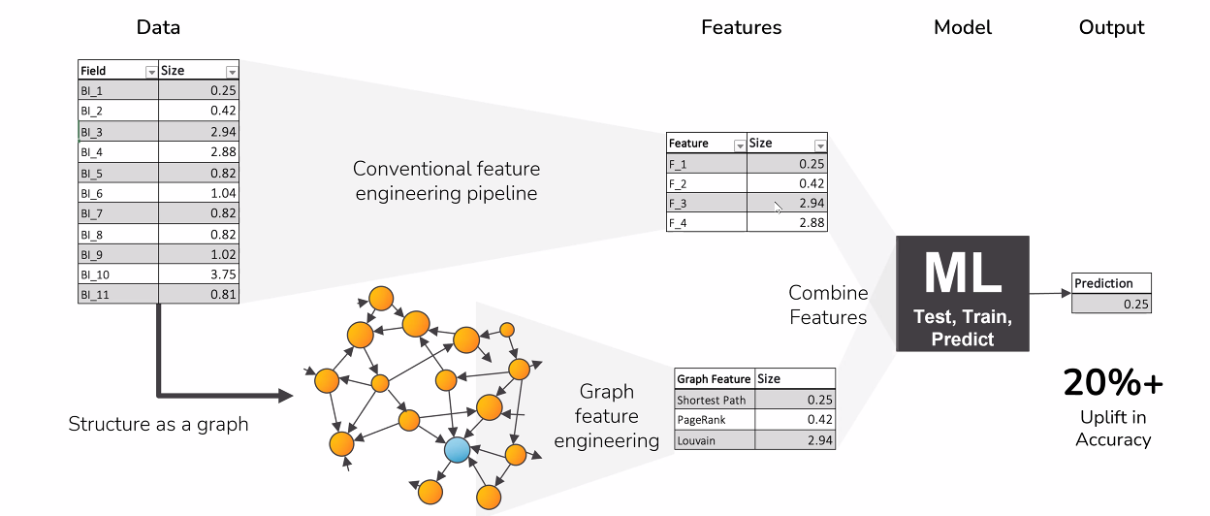
Graph ML
Network Propagation
Centrality algorithms
Community detection
Similarity
Link prediction
Shortest path

Slide 24
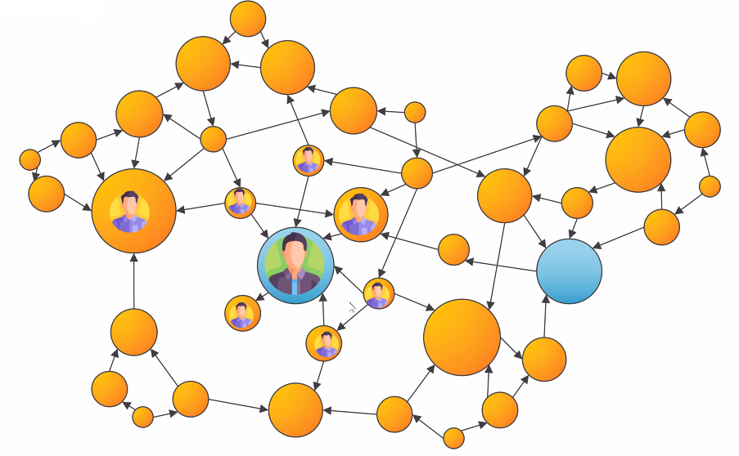
Centrality

Slide 25
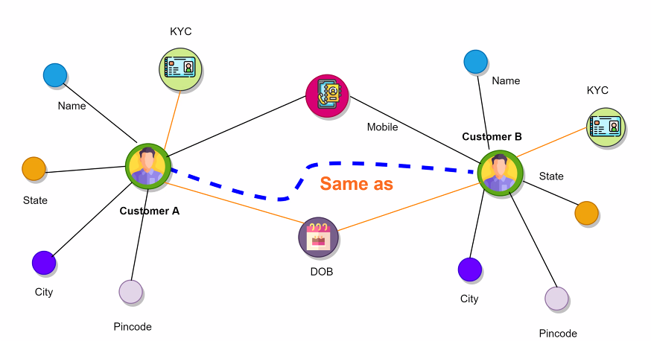
Similarity

Slide 26
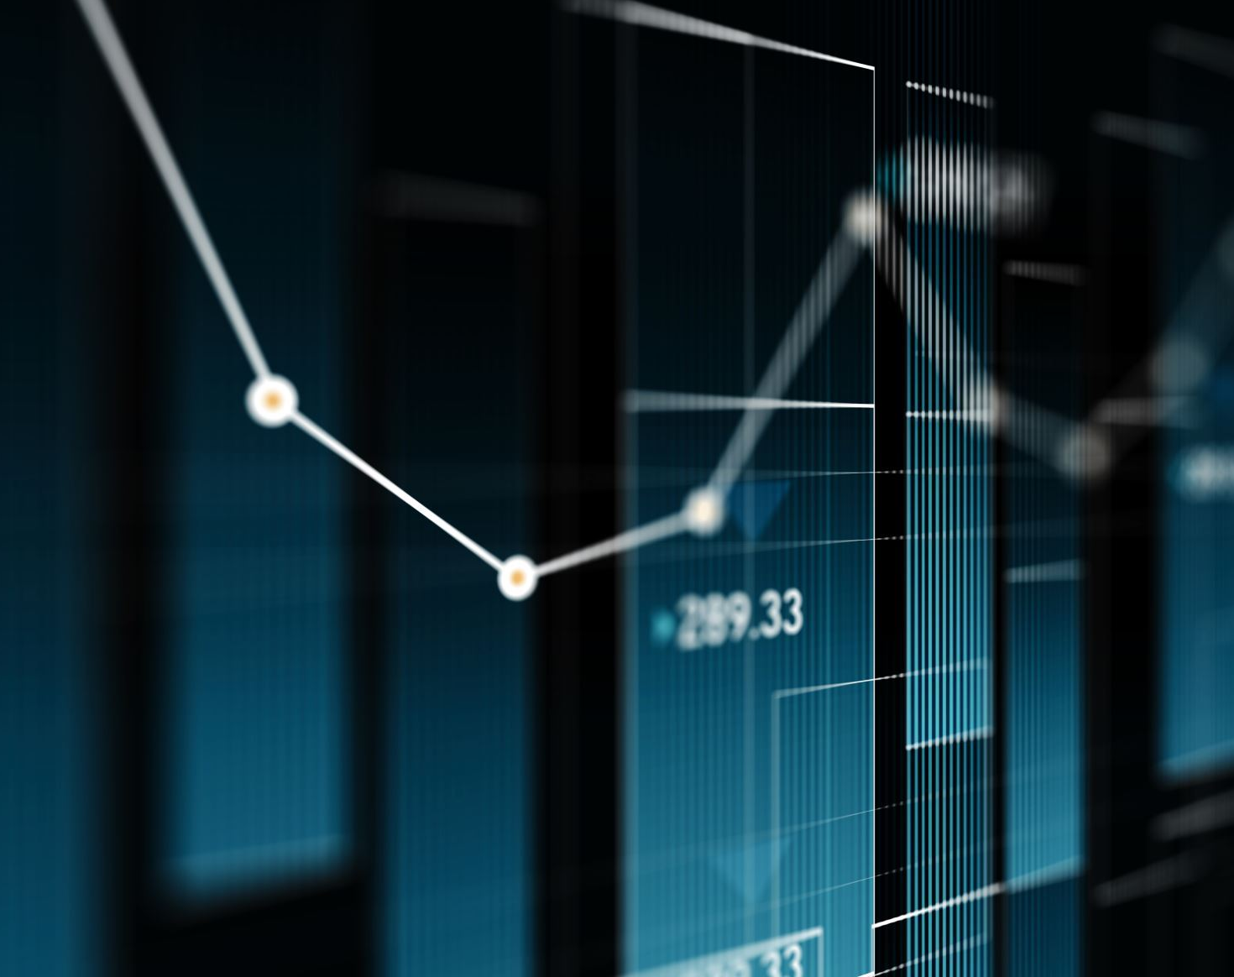
Is Graph ML sufficient?

Slide 27
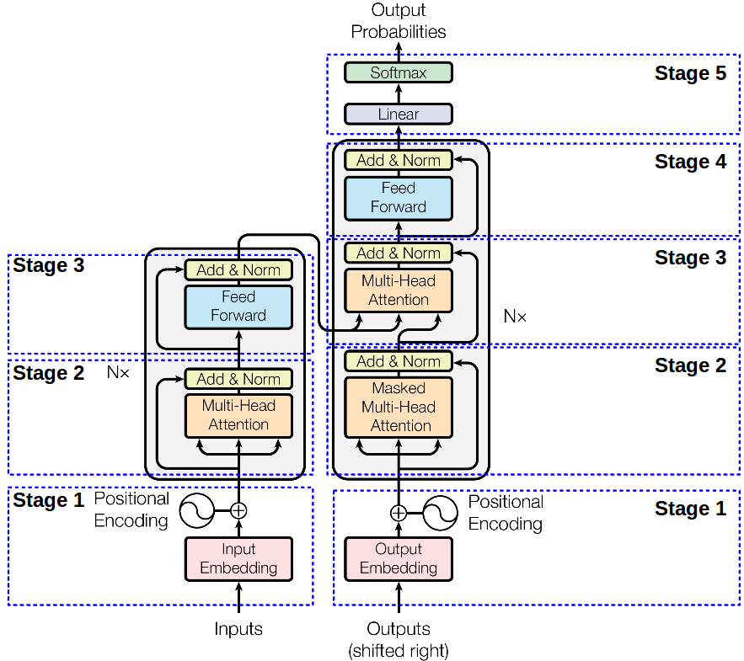
LLM evolution
“Attention is All You Need”
https://doi.org/10.48550/arXiv.1706.03762

Slide 28
LLM evolution
Model Name | Date of Launch | Objective | Number of Parameters | Training Tokens | Company
BERT | October 2018 | NLP tasks like question answering and sentiment analysis | 340 million | 3.3 billion | Google
GPT-3 | June 2020 | General-purpose AI | 175 billion | 570 billion | OpenAI
GPT-3.5 | November 2022 | Improved general-purpose AI | 175 billion | 570 billion | OpenAI
PaLM | April 2022 | Multilingual and multitask AI | 540 billion | 780 billion | Google
GPT-4 | March 2023 | General-purpose AI | 175 billion | 570 billion | OpenAI
LLaMA 2 | July 2023 | Research and commercial use | 70 billion | 1.4 trillion | Meta
Claude 2 | July 2023 | Conversational AI | 52 billion | 1.2 trillion | Anthropic
PaLM 2 | May 2023 | Multilingual and multitask AI | 540 billion | 780 billion | Google
Mistral | August 2024 | High-performance AI | 13 billion | 1 trillion | Mistral AI
Gemini 1.5 | August 2024 | General-purpose AI | 27 billion | 1.5 trillion | Google DeepMind

Slide 29
Challenges
KG Limitations
Construction complexity
Schema alignments
LLM limitations
Hallucination
Interpretability and Explainability
Resource intensive
Fine tuning
Contextual Understanding
No source and out of date

Slide 30
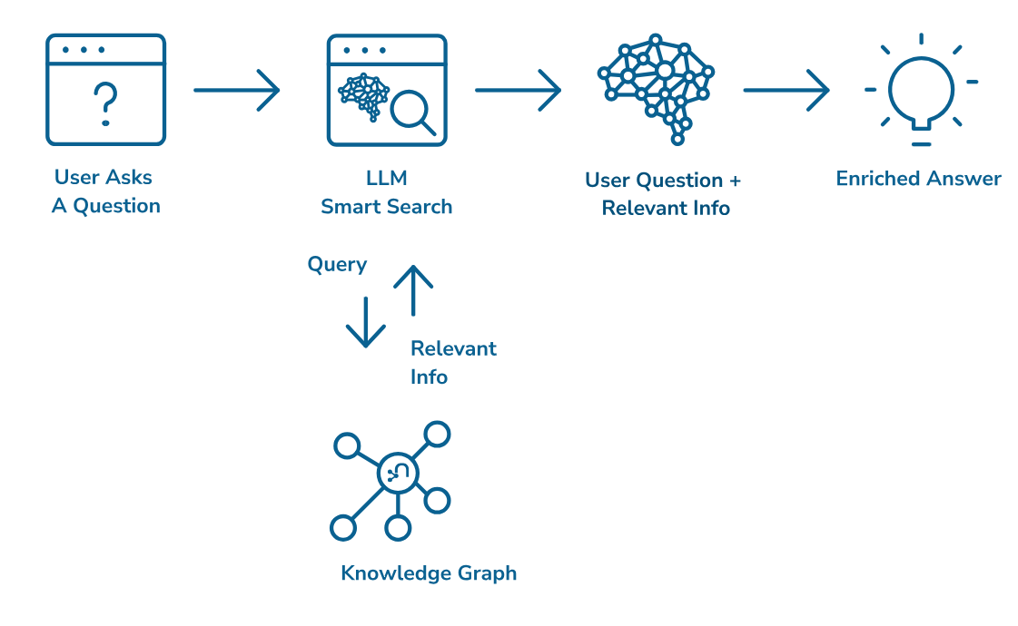
Why Graphs + LLMs
Advantages
Contextual Understanding and Accuracy
Depth of Knowledge
Interpretability and Explainability
Personalized Responses
Domain specific accuracy
Source: Neo4J
Notes:
Contextual Understanding and Accuracy:
LLMs excel in language understanding and generation, while KGs provide structured knowledge and factual accuracy.
By integrating both, AI systems can offer solutions that are linguistically convincing and deeply informed by real-world knowledge.
This synergy ensures contextually rich and accurate responses in applications like legal research, healthcare, and customer relationship management (CRM) ¹.
Depth of Knowledge:
KGs encapsulate entities and their relationships, forming a network of knowledge.
LLMs, trained on textual data, benefit from KGs’ depth of knowledge beyond what they typically learn from raw text.
This depth enhances AI systems’ ability to provide informed answers and insights ¹.
Interpretability and Explainability:
KGs act as validators for LLM-generated text.
When LLMs generate responses, KGs verify the factual correctness and coherence.
This validation ensures that AI systems provide accurate and reliable information ².
Personalized Responses:
KGs enhance contextual relevance by providing personalized information.
LLMs, when combined with KGs, can tailor responses based on structured knowledge about specific users or domains.
Personalization improves user experience and engagement ¹.
Domain-Specific Accuracy:
KGs contain domain-specific facts and relationships.
LLMs, when guided by KGs, can offer precise and domain-specific answers.
For instance, in medical applications, combining KGs with LLMs ensures accurate and context-aware responses ³.
Structured Data Handling:
KGs provide structured data beyond plain text.
LLMs can leverage this structured information for more precise content generation.
Structured data from KGs enriches LLM-generated content, making it more reliable and relevant ¹.

Slide 31
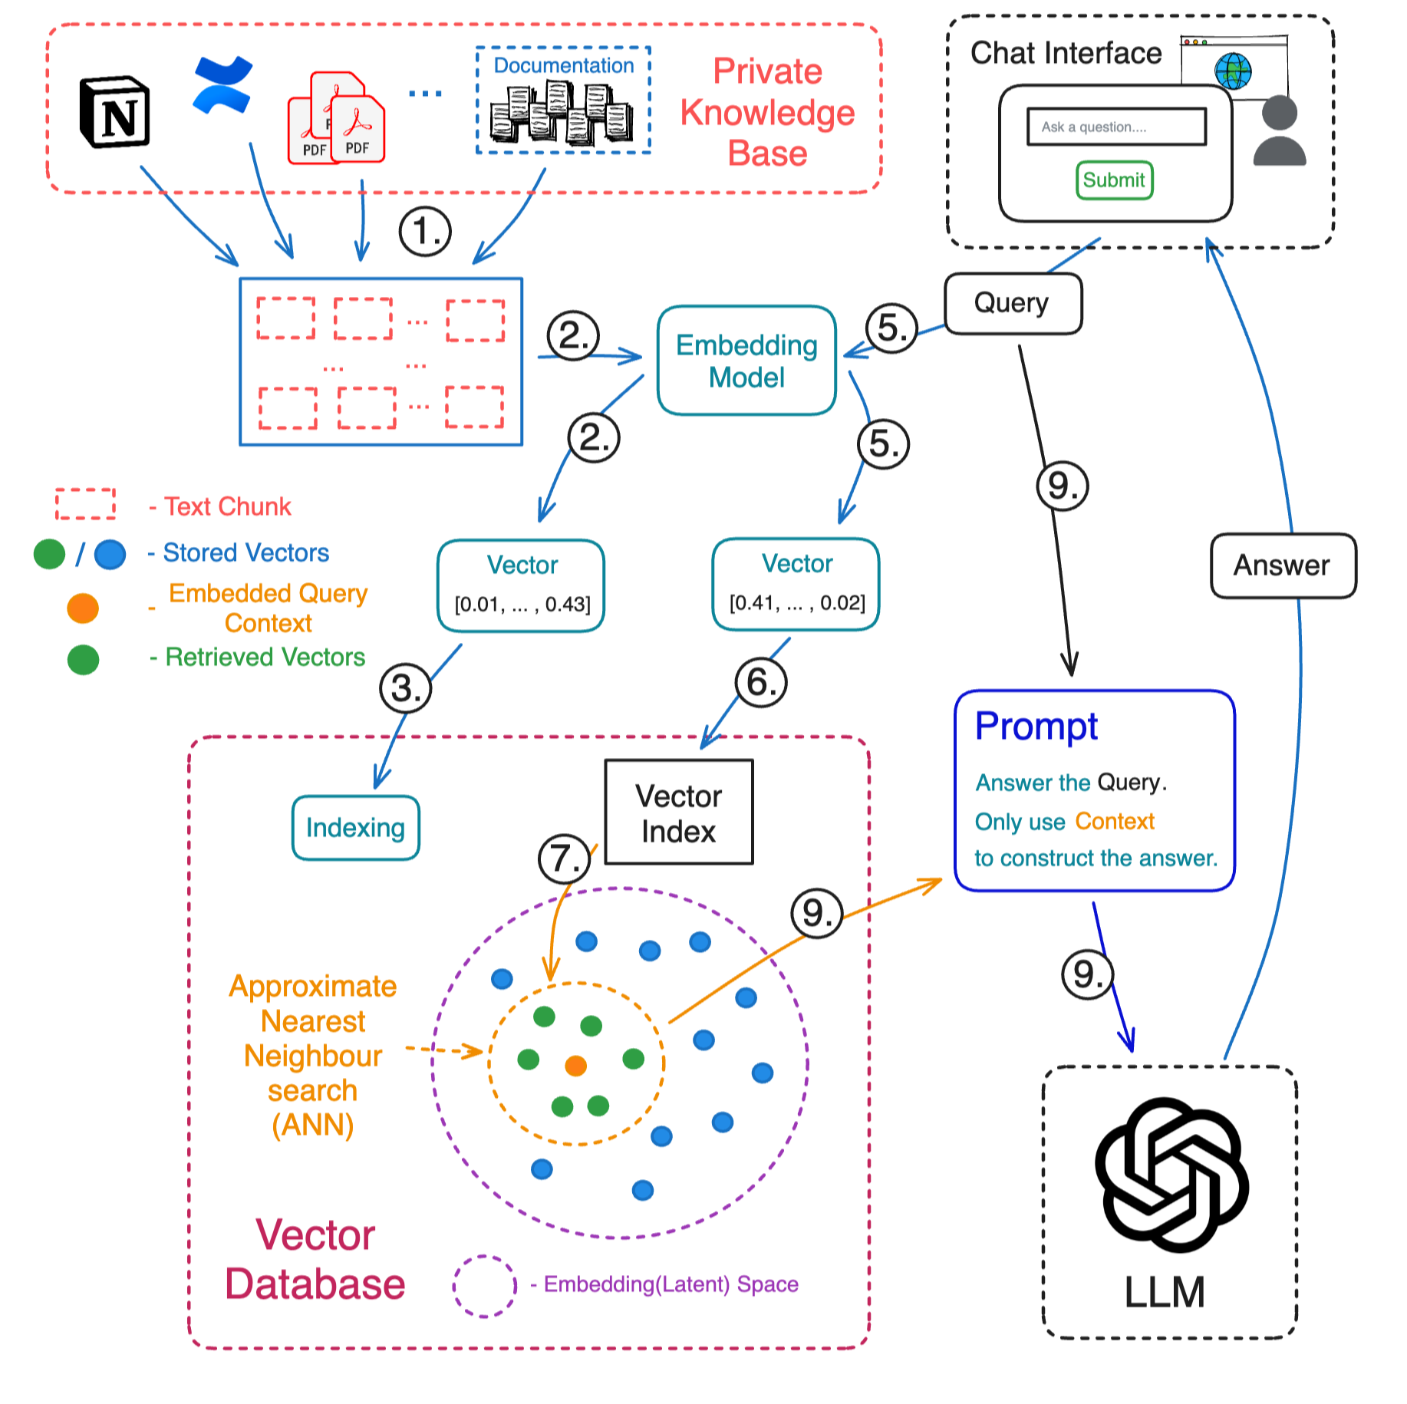
RAG
Source: https://www.linkedin.com/in/aurimas-griciunas/

Slide 32
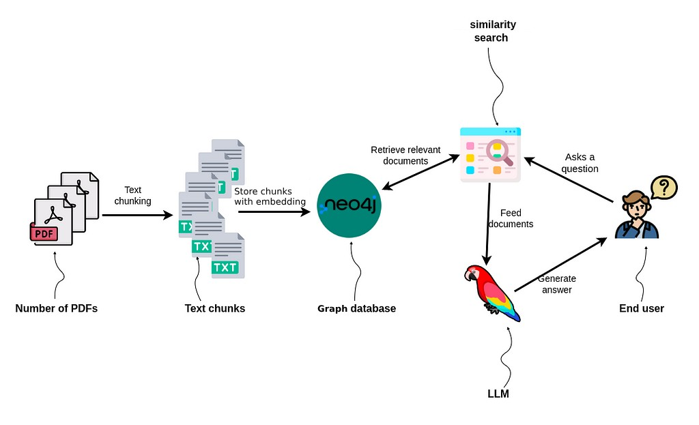
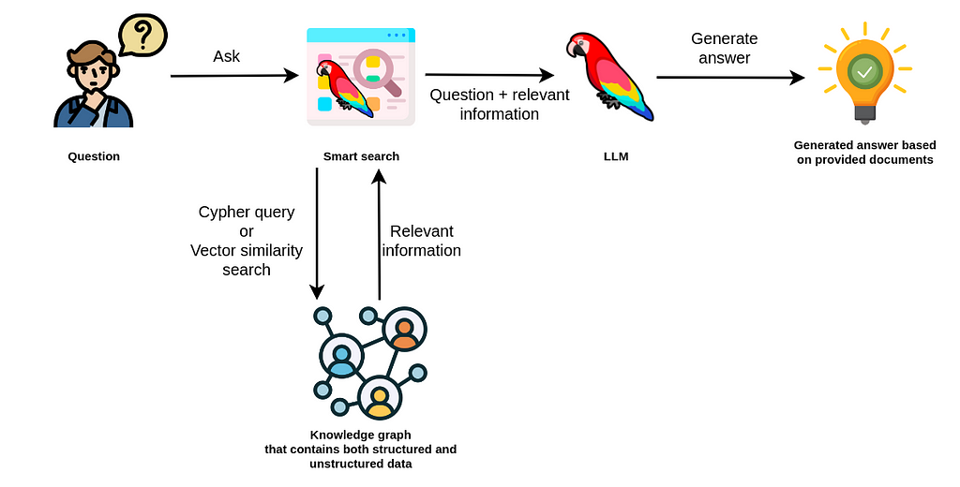
RAG with Vector Databases vs Graphs
LLMs & Knowledge Graphs (Photo by Tomaz Bratanic)

Slide 33
Current Trends
Personalised AI assistants and Chatbots
Content Generation and summarization – health records, clinical documents
Multilingual communication and translation
Personalized recommendations
Pharma and biomedical research
Enterprise knowledge management
Smart cities and IoT

Slide 34
Open Datasets for Research
ClinicalTrials.gov
National Center for Biotechnology Information (NCBI)
European Union Clinical Trials Register (EU-CTR)
OpenTrials.net
Project Data Sphere
Cancer Imaging Archive (TCIA)
Medical Information Mart for Intensive Care (MIMIC-III)

Slide 35

Pharma use cases
Life sciences

Slide 36

Why?
Time
10 years for discovery to market
7-8 years for clinical trials
Cost
$314M to $2.8B (median $985M)
Includes cost of failures
Success rate < 12%

Slide 37
Pharma Ontologies and Taxonomies
Ontology/Taxonomy | Description
Gene Ontology (GO) | Provides a framework for the representation of gene and gene product attributes across species and databases.
SNOMED CT (Systematized Nomenclature of Medicine - Clinical Terms) | A comprehensive clinical terminology that provides a standardized way to represent medical terms.
ChEBI (Chemical Entities of Biological Interest) | A dictionary of molecular entities focused on ‘small’ chemical compounds.
NCIT (National Cancer Institute Thesaurus) | Provides a reference terminology for cancer research.
LOINC (Logical Observation Identifiers Names and Codes) | Used for identifying health measurements, observations, and documents.
UMLS (Unified Medical Language System) | Integrates and distributes key terminology, classification, and coding standards.
MeSH (Medical Subject Headings) | A comprehensive controlled vocabulary for the purpose of indexing journal articles and books in the life sciences1.
MedDRA (Medical Dictionary for Regulatory Activities) | An international medical terminology used for data entry, retrieval, analysis, and display in drug development2.

Slide 38
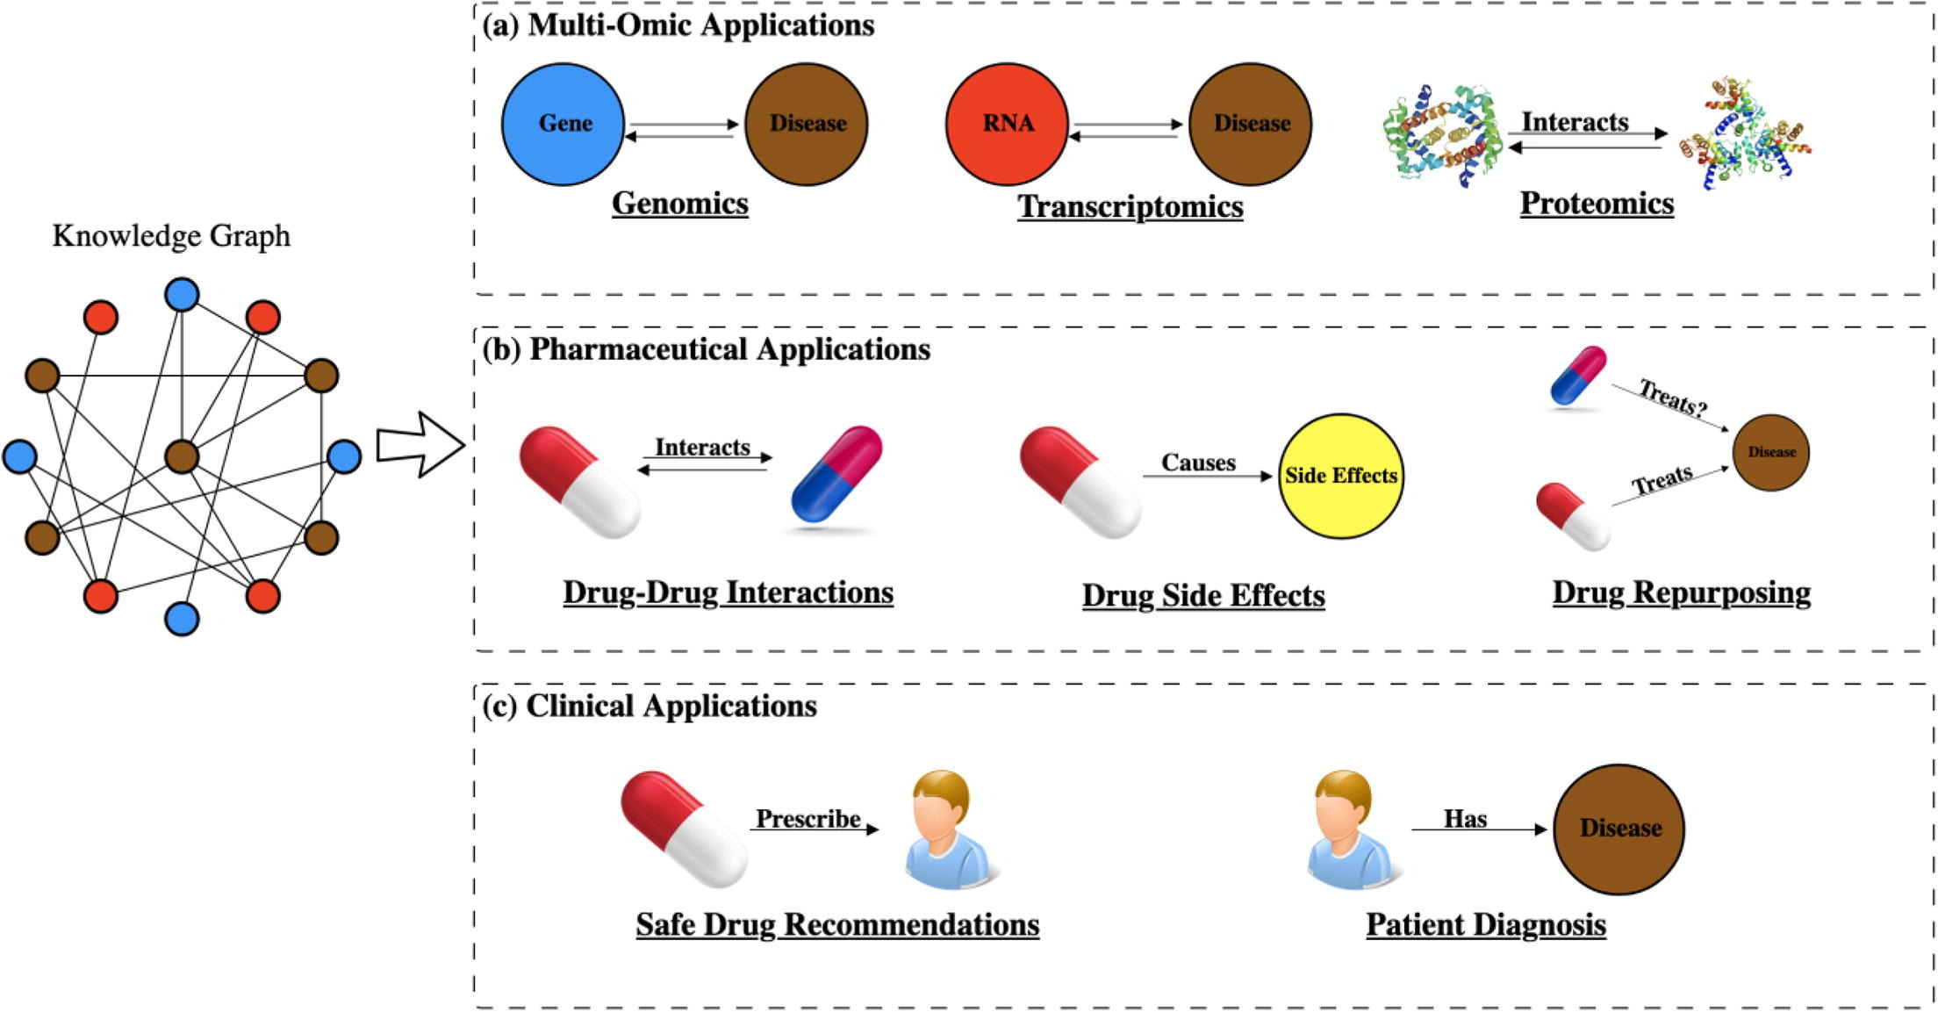
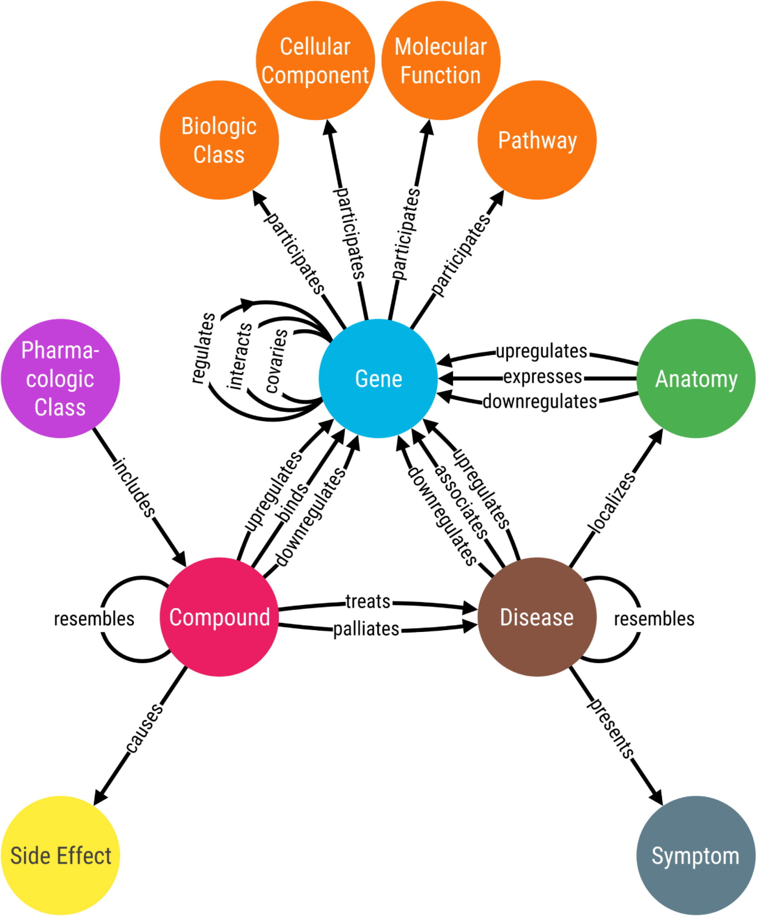
Use case – Drug Development
Courtesy: https://doi.org/10.1016/j.csbj.2020.05.017

Slide 39
Use case – Drug Development
Target Identification – potential drug targets
Drug Repurposing – hidden connections between drugs and diseases
Precision Medicine – targeted treatments and therapies
Clinical Trials – patient recruitment, trial optimization – identifying potential bio markers.
Courtesy: https://doi.org/10.1016/j.csbj.2020.05.017

Slide 40
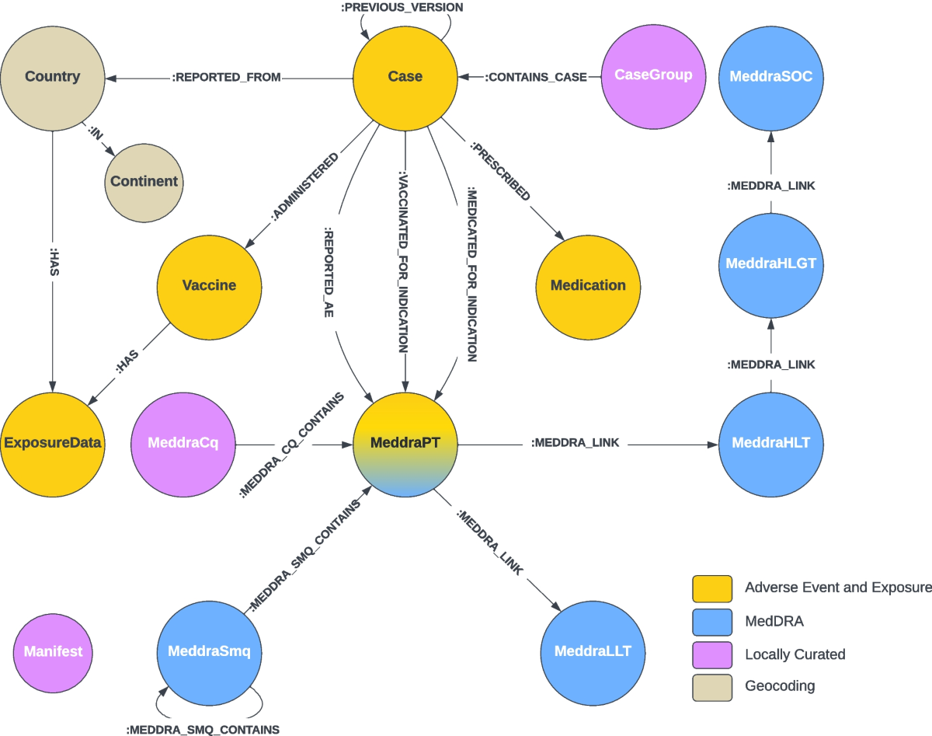
Use case – PharmaCovigilance – signal detection
Integration of Diverse data sources – clinical trials, health records, event reports
Detection of Adverse Drug Reactions (ADRs) - early detection and prevention
Enhanced Drug Safety Analysis – Drug – Drug Interactions, better patient outcomes
Signal Detection and Monitoring – drug safety signals
Regulatory and Compliance reporting – submissions to health authorities

Slide 41
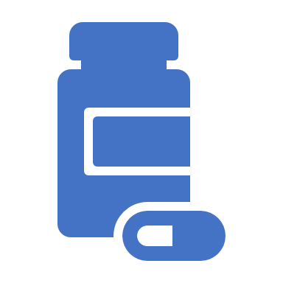
Possible Directions
Explainable AI (Pharma)
Automated compliance reporting (Pharma and finance)
Multi Omics data integration (Pharma)
Audience analysis – content curation (Pharma and Media)
Supply chain optimization - (Pharma and Retail)
Notes:
Healthcare and Life Sciences:
Personalized Medicine: Integrating patient data, genetic information, and treatment outcomes to tailor personalized treatment plans1.
Drug Discovery: Accelerating the identification of new drug candidates by analyzing complex biological data and uncovering hidden connections1.
Finance:
Fraud Detection: Identifying fraudulent activities by analyzing transaction patterns and relationships between entities2.
Risk Management: Enhancing risk assessment by integrating diverse financial data sources and identifying potential risks2.
Retail and E-commerce:
Personalized Recommendations: Improving product recommendations by understanding customer preferences and behavior3.
Supply Chain Optimization: Enhancing supply chain efficiency by mapping relationships between suppliers, products, and logistics3.
Manufacturing:
Predictive Maintenance: Predicting equipment failures by analyzing sensor data and maintenance records4.
Quality Control: Improving product quality by identifying patterns and anomalies in production data4.
Telecommunications:
Network Optimization: Enhancing network performance by analyzing data from various network components and identifying bottlenecks.
Customer Experience: Improving customer service by integrating and analyzing customer interaction data.
Energy:
Smart Grids: Optimizing energy distribution by analyzing data from smart meters and other sources.
Renewable Energy Management: Enhancing the management of renewable energy sources by integrating weather data, energy production, and consumption patterns.
Legal and Compliance:
Regulatory Compliance: Ensuring compliance with regulations by integrating and analyzing legal documents and compliance data.
Contract Management: Streamlining contract management by mapping relationships between contract terms, parties, and obligations.
Media and Entertainment:
Content Recommendation: Enhancing content recommendations by understanding user preferences and content relationships.
Audience Analysis: Analyzing audience behavior and preferences to tailor content and marketing strategies.

Slide 42
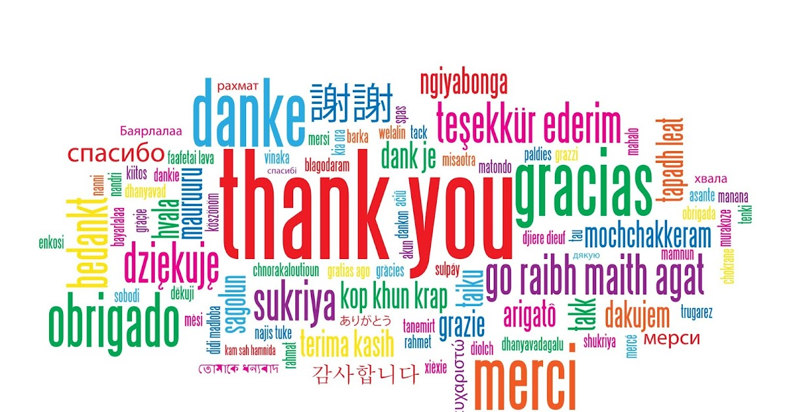
Email: mvk.kiran@outlook.com
WhatsApp: 9159250068
LinkedIn: https://www.linkedin.com/in/vamsee-krishna-kiran-muppavarapu/

Slide 44
Interesting Facts about Data
In 2020, each human created 1.7 MB of data every second.
By 2022, 70% of the globe’s GDP will have undergone digitization.
In 2021, 68% of Instagram users view photos from brands.
By 2025, 200+ zettabytes of data will be in cloud storage around the globe.
In 2020, users sent around 500,000 Tweets per day.
By the end of 2020, 44 zettabytes made up the entire digital universe.
Every day, 306.4 billion emails are sent, and 500 million Tweets are made.
We created 2.5 quintillion data bytes daily in 2020
463 exabytes of data will be generated each day by 2025

Slide 45
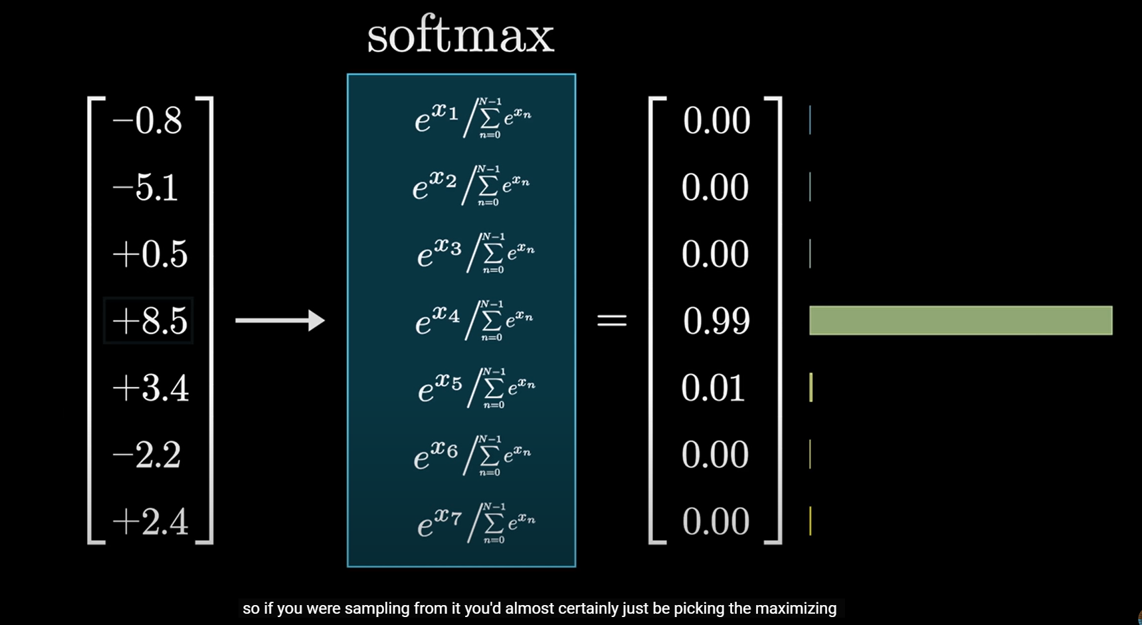
Introduction
Title Slide: “Synergy of Knowledge Graphs and Machine Learning: Transforming Data into Actionable Insights”
Briefly introduce the topic and its significance.
Knowledge Graphs (KGs) Explained
What is a knowledge graph?
How KGs represent information as interconnected entities.
Importance of ontologies in enriching KGs.
Machine Learning (ML) Overview
Definition of ML.
Role of ML in data analysis and prediction.
Challenges and opportunities in ML.
The Power of Synergy
How KGs and ML can complement each other.
Benefits of integrating KGs with ML models.
Examples of successful synergy.
Transforming Unstructured Text into KGs
Demonstrate how ML models (e.g., LLMs) can extract entities and relationships from unstructured text.
Discuss the value of storing data within KGs.
Enhancing ML Reasoning with KGs
How ML applications can seamlessly interact with structured knowledge in KGs.
Use cases where KGs guide ML reasoning.
Business Use Case: LLM-Based Question Answering
Present a practical example of building an LLM-based question answering system.
Show how prompting LLMs with KGs enhances their capabilities.
Tools and Technologies
Mention relevant tools (e.g., Neo4j, Stardog) for creating and managing KGs.
Highlight popular LLMs (e.g., GPT-3.5-turbo).
Real-World Impact
Discuss how this synergy leads to actionable insights.
Decision-making, predictions, and improved understanding.
Future Trends
Predictions for the evolution of KG-ML synergy.
Emerging research areas.
Q&A Session
Engage with the audience and address their queries.

Slide 46
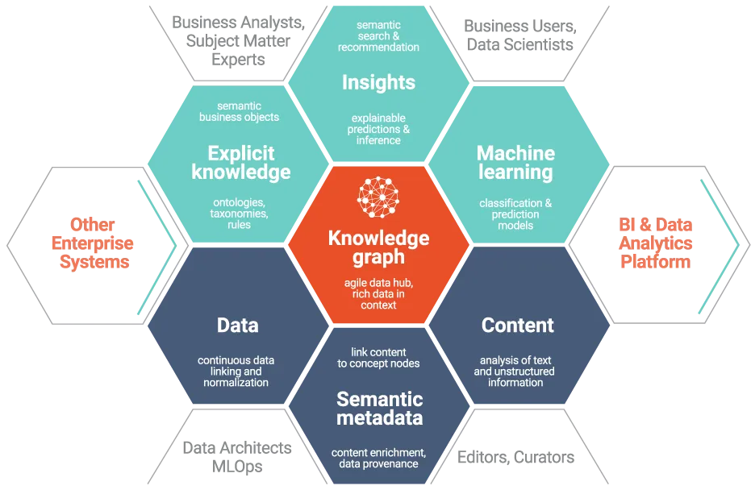

Slide 47
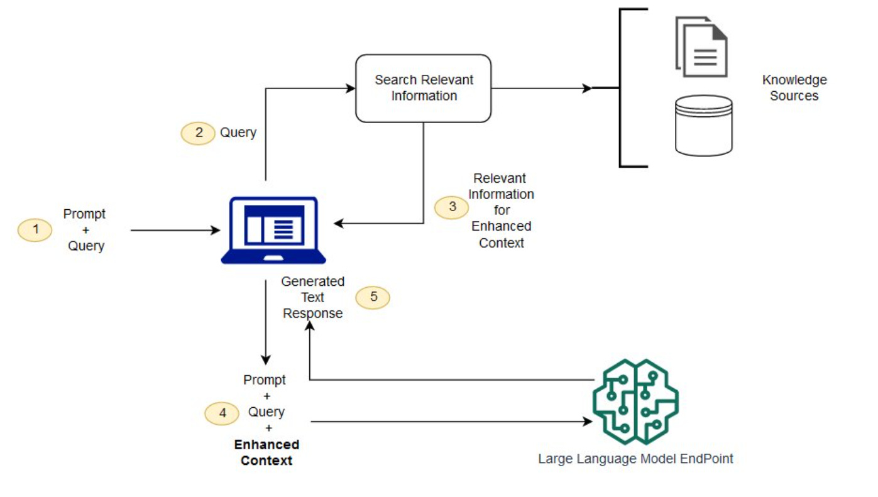
RAG Architecture

Slide 48
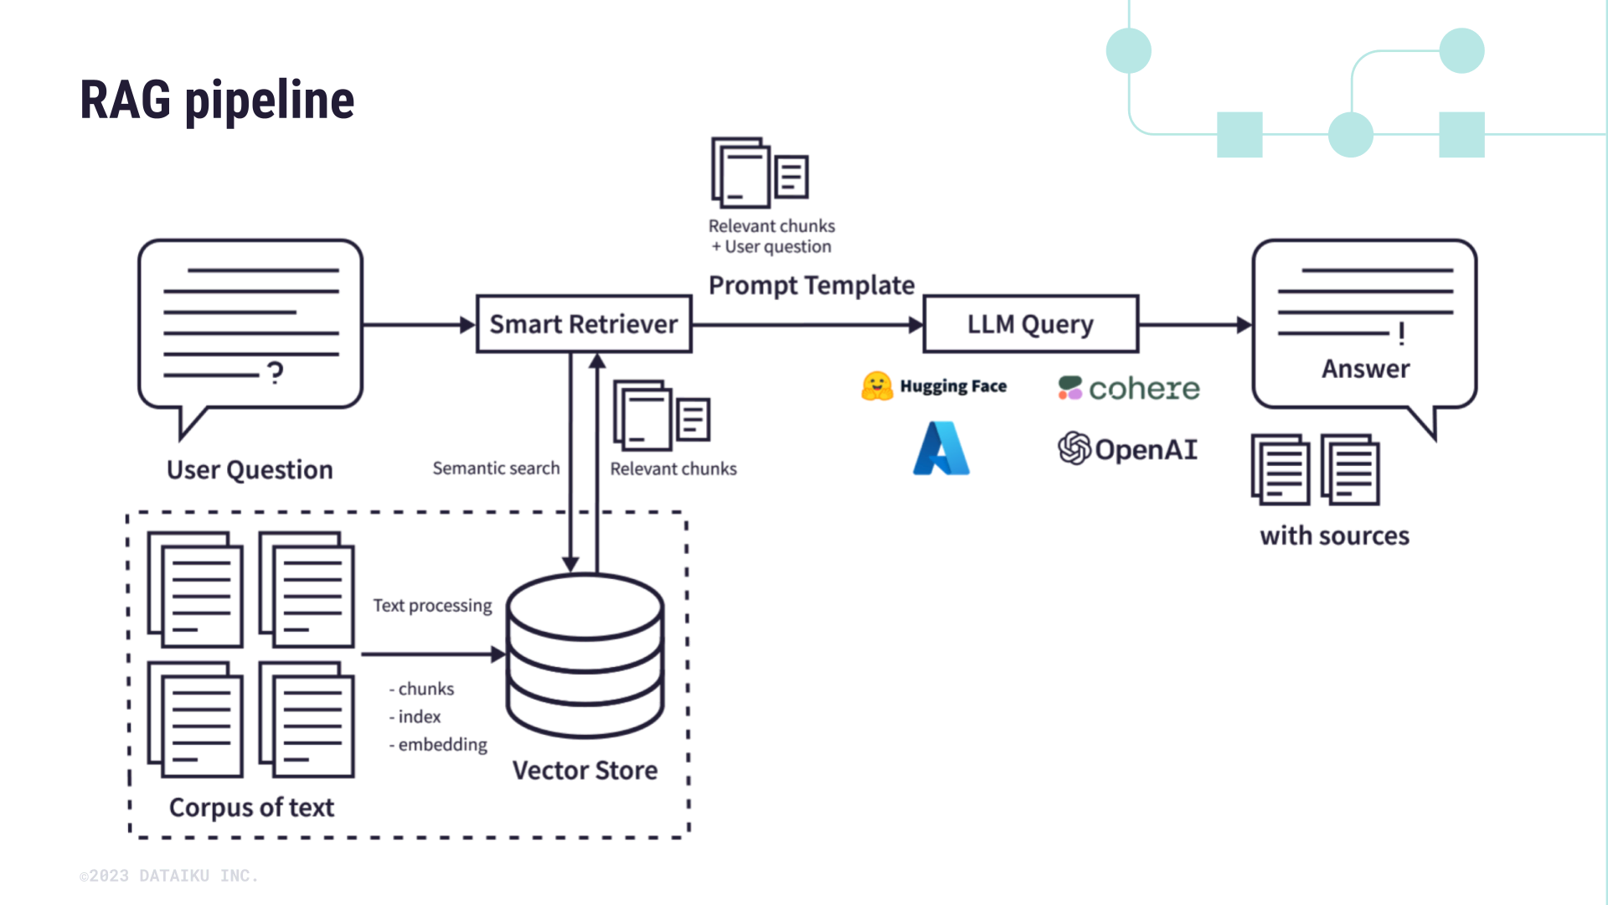

Slide 49
Why Graphs in LLMs?
KGs facilitate the integration of factual information into LLM-generated text.
KGs inject a semantic layer of contextual depth into LLMs, enabling them to grasp and process language with a more nuanced understanding of the subject matter.
This guidance minimizes the chances of LLMs generating hallucinated or implausible content
KG-enhanced LLMs: Incorporating KGs during pre-training and inference phases of LLMs.
LLM-augmented KGs: Leveraging LLMs for KG tasks such as embedding, completion, and question answering.
Synergized LLMs + KGs: Bidirectional reasoning driven by both data and knowledge

Slide 50
RAG
LLMs simplify information retrieval from KGs. They provide user-friendly access to complex data without needing data experts.
Instead of traditional database searches using programming languages, anyone can directly ask questions and receive summaries by prompting LLMs with KGs

Slide 51
